Slide 1
Image Processing with Python Blurring images
Dr. Candace Makeda Moore, MD
Jaro Camphuijsen, MSc
Giulia Crocioni, MSc
Thijs Vroegh, PhD
Notes:
In this episode, we will learn how to use skimage functions to blur images.

Slide 2
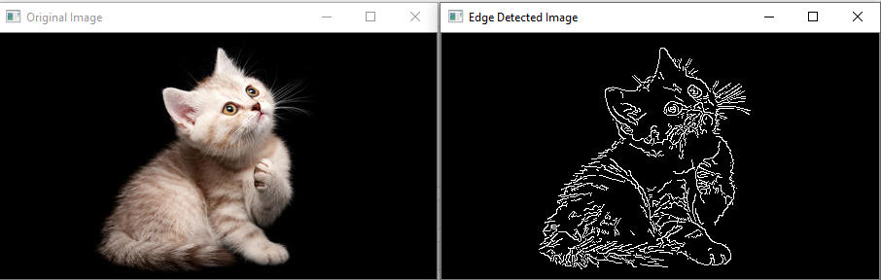

Blurring
Edges
Blurring
Notes:
When processing an image, we are often interested in identifying objects represented within it so that we can perform some further analysis of these objects e.g. by counting them, measuring their sizes, etc.
An important concept associated with the identification of objects in an image is that of edges: the lines that represent a transition from one group of similar pixels in the image to another different group. One example of an edge is the pixels that represent the boundaries of an object in an image, where the background of the image ends and the object begins.
When we blur an image, we make the colour transition from one side of an edge in the image to another smooth rather than sudden. The effect is to average out rapid changes in pixel intensity.
Blurring is to make something less clear or distinct. This could be interpreted quite broadly in the context of image analysis - anything that reduces or distorts the detail of an image might apply.
A blur is a very common operation we need to perform before other tasks such as thresholding.

Slide 3
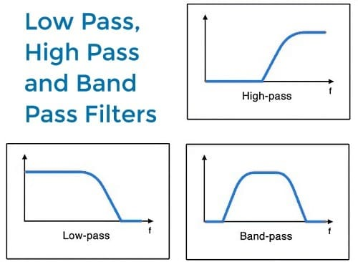
Filters
High-pass
Attenuating low frequency components
Keeping smaller details
E.g. Edge filters
Low-pass
Attenuating high frequency components
Keeping larger features
E.g. Smoothening filters
Notes:
In the day-to-day, macroscopic world, we have physical filters which separate out objects by size. A filter with small holes allows only small objects through, leaving larger objects behind. This is a good analogy for image filters. A high-pass filter will retain the smaller details in an image, filtering out the larger ones. A low-pass filter retains the larger features, analogous to what’s left behind by a physical filter mesh. High- and low-pass, here, refer to high and low spatial frequencies in the image.
[Images are 2D functions f(x,y) in spatial coordinates (x,y) in an image plane. All images can thus be decomposed using Fourier analysis into planar waves with various frequencies, phases, amplitudes, and orientations. This dual representation by a spectrum of different frequency components is completely equivalent to the conventional spatial representation: the direct conversion of a 2D spatial function f(x,y) into the 2D spectrum F(u,v) of spatial frequencies and the reverse conversion of the latter into a spatial representation f(x,y) are lossless, i.e. involve no loss of information. Such spectral representation sometimes simplifies image processing. The human visual cortex contains cells that respond to sinusoidal spatial frequencies in different orientations.]
Details associated with high spatial frequencies are small, a lot of these features would fit across an image. Features associated with low spatial frequencies are large - maybe a couple of big features per image.

Slide 4
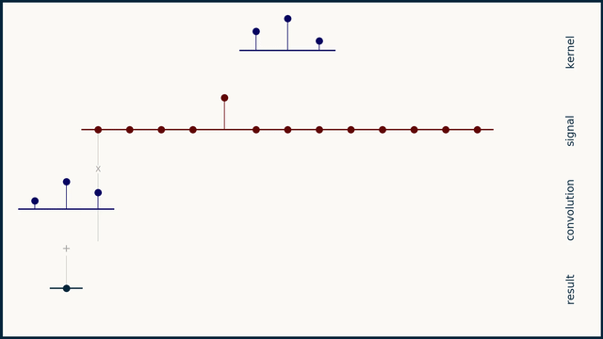
Kernels
Implement filters on images
2D Convolution operation between the kernel and an image
1D Convolution
Notes:
A kernel can be used to implement a filter on an image. A kernel, in this context, is a small matrix which is combined with the image using a mathematical technique: convolution.
The math behind convolution is a combination of multiplication and addition. We can best get a feel for convolution by looking at a one dimensional signal. In this animation, we see a shorter sequence, the kernel, being convolved with a longer sequence, the signal.
Step the kernel along the signal one data point at a time
At each position, calculate the dot product of the two
3.1 Multiply each pair of aligned values together
3.2 Add up those products
The resulting sequence of dot products is the convolution of the kernel with the signal

Slide 5
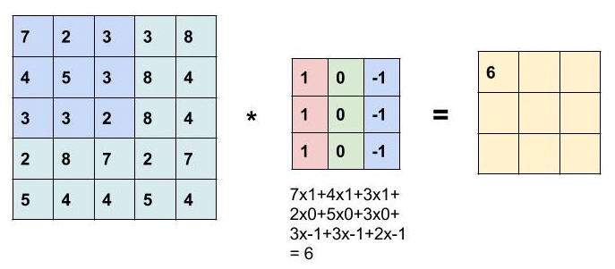
Kernels
Implement filters on images
2D Convolution operation between the kernel and an image
1D Convolution
2D Convolution
Notes:
In the 2D case, the kernel can be thought of as a little image in itself, and will favour features of a similar size and shape in the main image. The width and height of the kernel must be an odd number, so that the pixel being worked on is always in its centre. In the example shown above, the kernel is square, with a dimension of 9 pixels.
Convolution is the process of adding each element of the image to its local neighbors, weighted by the kernel.

Slide 6
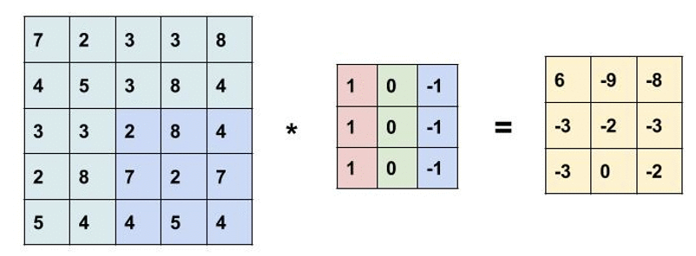
Padding
Using small filters the image size decreases
5x5 input image
3x3 filter
3x3 filtered image
Notes:
Every time we use the filter (a.k.a. kernel) to scan the image, the size of the image will go smaller and smaller. We don’t want that, because we wanna preserve the original size of the image to extract some low level features. Therefore, we will add some extra pixels outside the image!
Since we typically use small kernels, for any given convolution, we might only lose a few pixels.

Slide 7
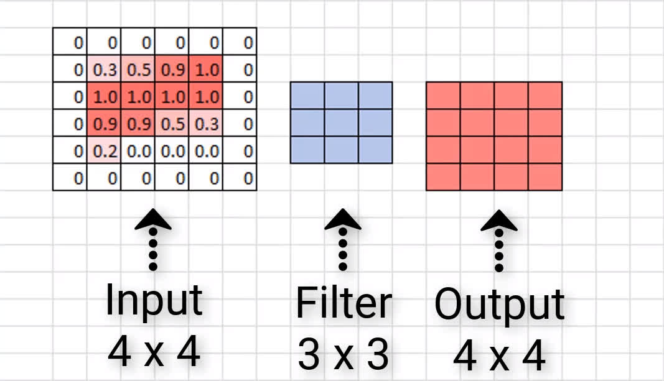
Padding
Using small filters the image size decreases
Straightforward solution
Adding extra pixels around the original image (padding)
Notes:
One straightforward solution to this problem is to add extra pixels of filler around the boundary of our input image, thus increasing the effective size of the image. Typically, we set the values of the extra pixels to zero.

Slide 8
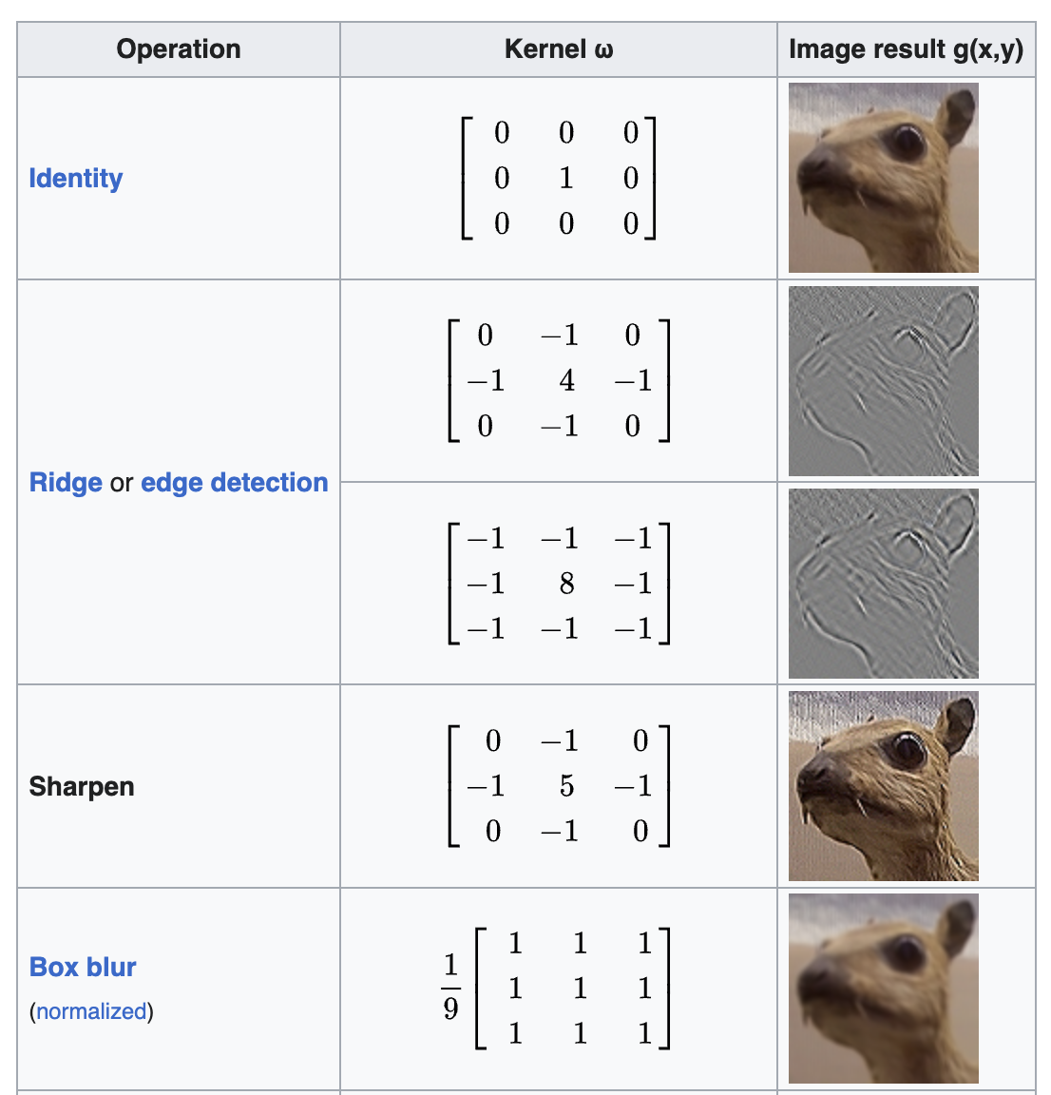
Kernels
Notes:
Different sizes, shapes and contents of kernel produce different effects.

Slide 9
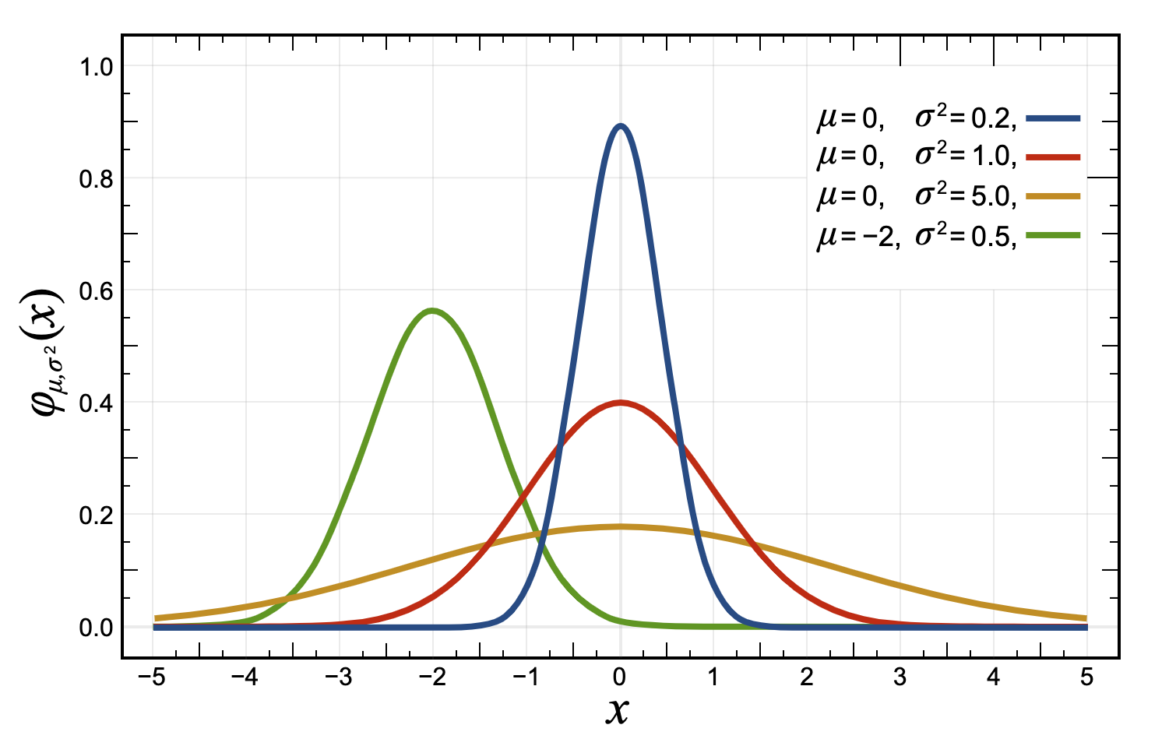
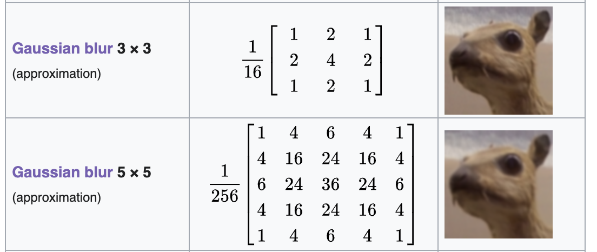
Gaussian blur
Makes use of a Gaussian kernel
Gaussian function
Reduce image noise
Reduce detail (low-pass filter)
Notes:
There are several different blurring functions in the skimage.filters module, so we will focus on just one here, the Gaussian blur.
A Gaussian blur is a filter that makes use of a Gaussian kernel.
In a Gaussian blur, the pixels nearest the centre of the kernel are given more weight than those far away from the centre. The rate at which this weight diminishes is determined by a Gaussian function, hence the name Gaussian blur. A Gaussian function maps random variables into a normal distribution or “Bell Curve”. The shape of the function is described by a mean value μ, and a variance value σ². The mean determines the central point of the bell curve on the x axis, and the variance describes the spread of the curve.

Slide 10
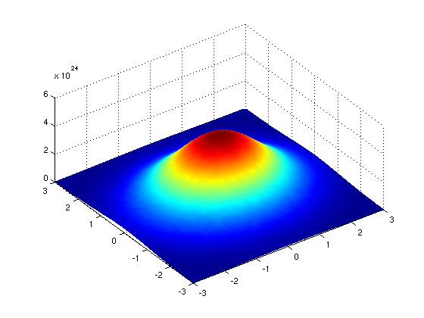
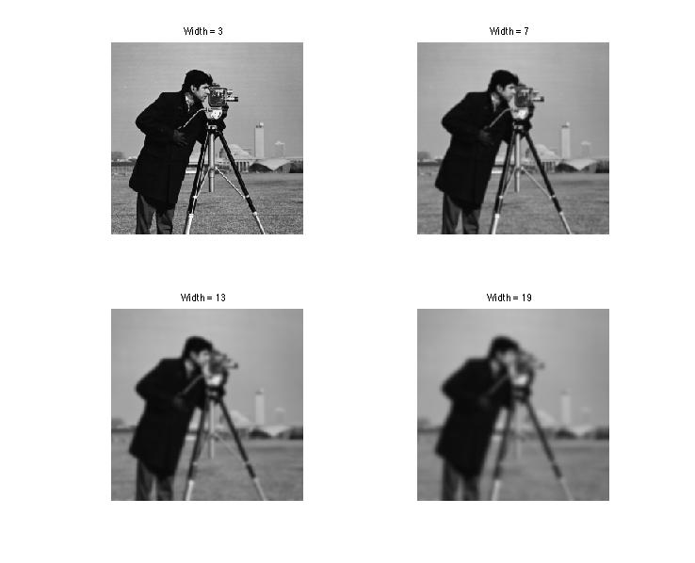
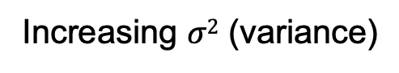
Gaussian blur
Increasing $σ2$ (variance)
Notes:
In fact, when using Gaussian functions in Gaussian blurring, we use a 2D Gaussian function to account for X and Y dimensions, but the same rules apply. The mean μ is always 0, and represents the middle of the 2D kernel. Increasing values of σ² in either dimension increases the amount of blurring in that dimension.

Slide 11
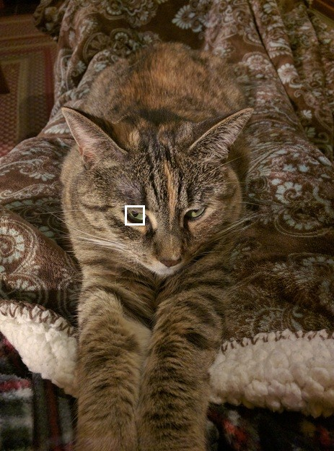
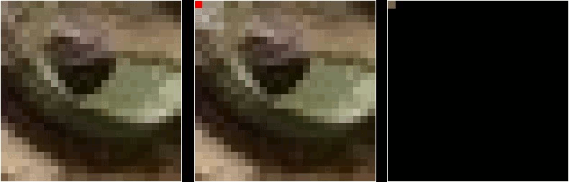
Gaussian blur
Notes:
This animation shows how the blur kernel moves along in the original image in order to calculate the colour channel values for the blurred image.
skimage has built-in functions to perform blurring for us, so we do not have to perform all of these mathematical operations ourselves. Let’s work through an example of blurring an image with the skimage Gaussian blur function.

